Slide 1



Survey of
Client Selection Methods in Federated
Learning
Neelkamal
Neilabh
Team: Honey, I Shrunk the Model
Shaun
Shreya
Notes:
Author name

Slide 2

Outline
Introduction
Unbiased Selection
Biased Selection
Results
What is Federated Learning? Problem Statement
1 Unbiased Client Selection Algorithm
2 Biased Client Selection Algorithms
Plots of Training and Testing Accuracies over time

Slide 3

01
Introduction

Slide 4
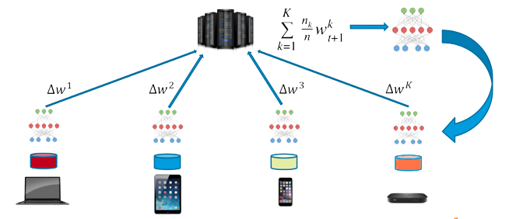
Introduction
Notes:
Federated Learning is a form of distributed learning with the key challenge being the non-identically distributed nature of the data in the participating clients. The popular federated averaging algorithm involves randomly selecting K clients out of a total of N available clients and then averaging the weight updates sent by the selected clients after a round’s training.

Slide 5
Problem Statement
Client Selection Policies -
Biased Selection
Unbiased Selection
Dataset (LEAF Benchmark):
Synthetic(α,β)
CelebA
shakespeare
Reddit
Criteria:
Evolution of training/validation accuracy during the training process
LEAF Federated Learning Benchmark
Notes:
We plan to explore different kinds of unbiased and biased client selection algorithms on the following datasets -
We plan to start with Synthetic(α, β) dataset and CelabA dataset as they are less computationally expensive and then we will move on to the NLP datasets (shakespeare and reddit)
Then, we will compare their performance with FedAvg.
Here, biased mean that the server will use any local training information of the clients.
And, unbiased means that the server will not use any local training information of the clients.

Slide 6
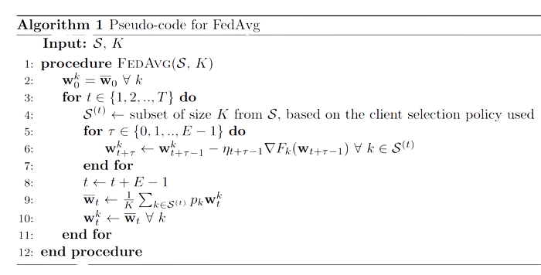
FedAvg

Slide 7
02
Biased Selection
Notes:
In biased selection, we use a scoring mechanism to rank clients and then select them according to the score

Slide 8
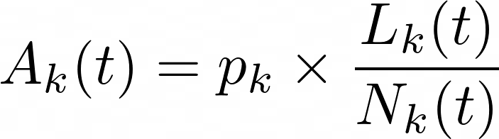
Policy 1 -
Score = Average Training Loss
Selecting K topmost clients with highest training loss.
Performs better than FedAvg.
Intuition: Poorly trained clients need more training
Score of k’th Client -
Notes:
The score is the average training loss.
The score of k’th client is …
Where, p_k is the fraction of total samples stored in client k,
L_k(t) is the cumulative loss of client k,
N_k(t) is the number of times client k is selected till time t.
So, as a client gets selected more, it’s score decreases.
Also, clients with high losses get selected first.

Slide 9
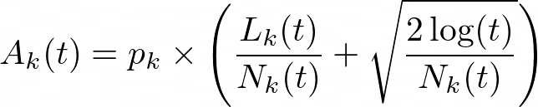
Policy 2 -
Score = Average Training Loss +
Exploration Term
Score of k’th Client -
Taking inspiration from the UCB algorithm in RL
Upper Confidence Bound (UCB) ensure a good balance between exploration and exploitation
Notes:
The score is the average training loss + an Exploration Term.
The score of k’th client is …
Where, p_k is the fraction of total samples stored in client k,
L_k(t) is the cumulative loss of client k,
N_k(t) is the number of times client k is selected till time t.
So, as a client gets selected more, it’s score decreases.
Also, clients with high losses get selected first.
At the same time, the 2nd term ensures exploration irrespective of ranking

Slide 10
03
Unbiased Selection
Notes:
In Unbiased Selection, we select the clients randomly, but in a different fashion than in FedAvg

Slide 11
Policy 3 - Sampling without Replacement
Advantages -
Uniform selection of clients
A client is not selected in back-to-back rounds
Clients sampled in the previous round are strictly not selected
Notes:
We plan to explore different kinds of unbiased and biased client selection algorithms on the following datasets -
We plan to start with Synthetic(α, β) dataset and CelabA dataset as they are less computationally expensive and then we will move on to the NLP datasets (shakespeare and reddit)
Then, we will compare their performance with FedAvg.
Here, biased mean that the server will use any local training information of the clients.
And, unbiased means that the server will not use any local training information of the clients.

Slide 12
04
Results
Notes:
In Unbiased Selection, we select the clients randomly, but in a different fashion than in FedAvg

Slide 13
Parameters
Model -
Multi-class Logistic Regression for 60-D vectors and 5 classes
Data generated from Synthetic(α,β) Dataset
N = 100 Clients
K = 5 Clients
Notes:
We plan to explore different kinds of unbiased and biased client selection algorithms on the following datasets -
We plan to start with Synthetic(α, β) dataset and CelabA dataset as they are less computationally expensive and then we will move on to the NLP datasets (shakespeare and reddit)
Then, we will compare their performance with FedAvg.
Here, biased mean that the server will use any local training information of the clients.
And, unbiased means that the server will not use any local training information of the clients.

Slide 14
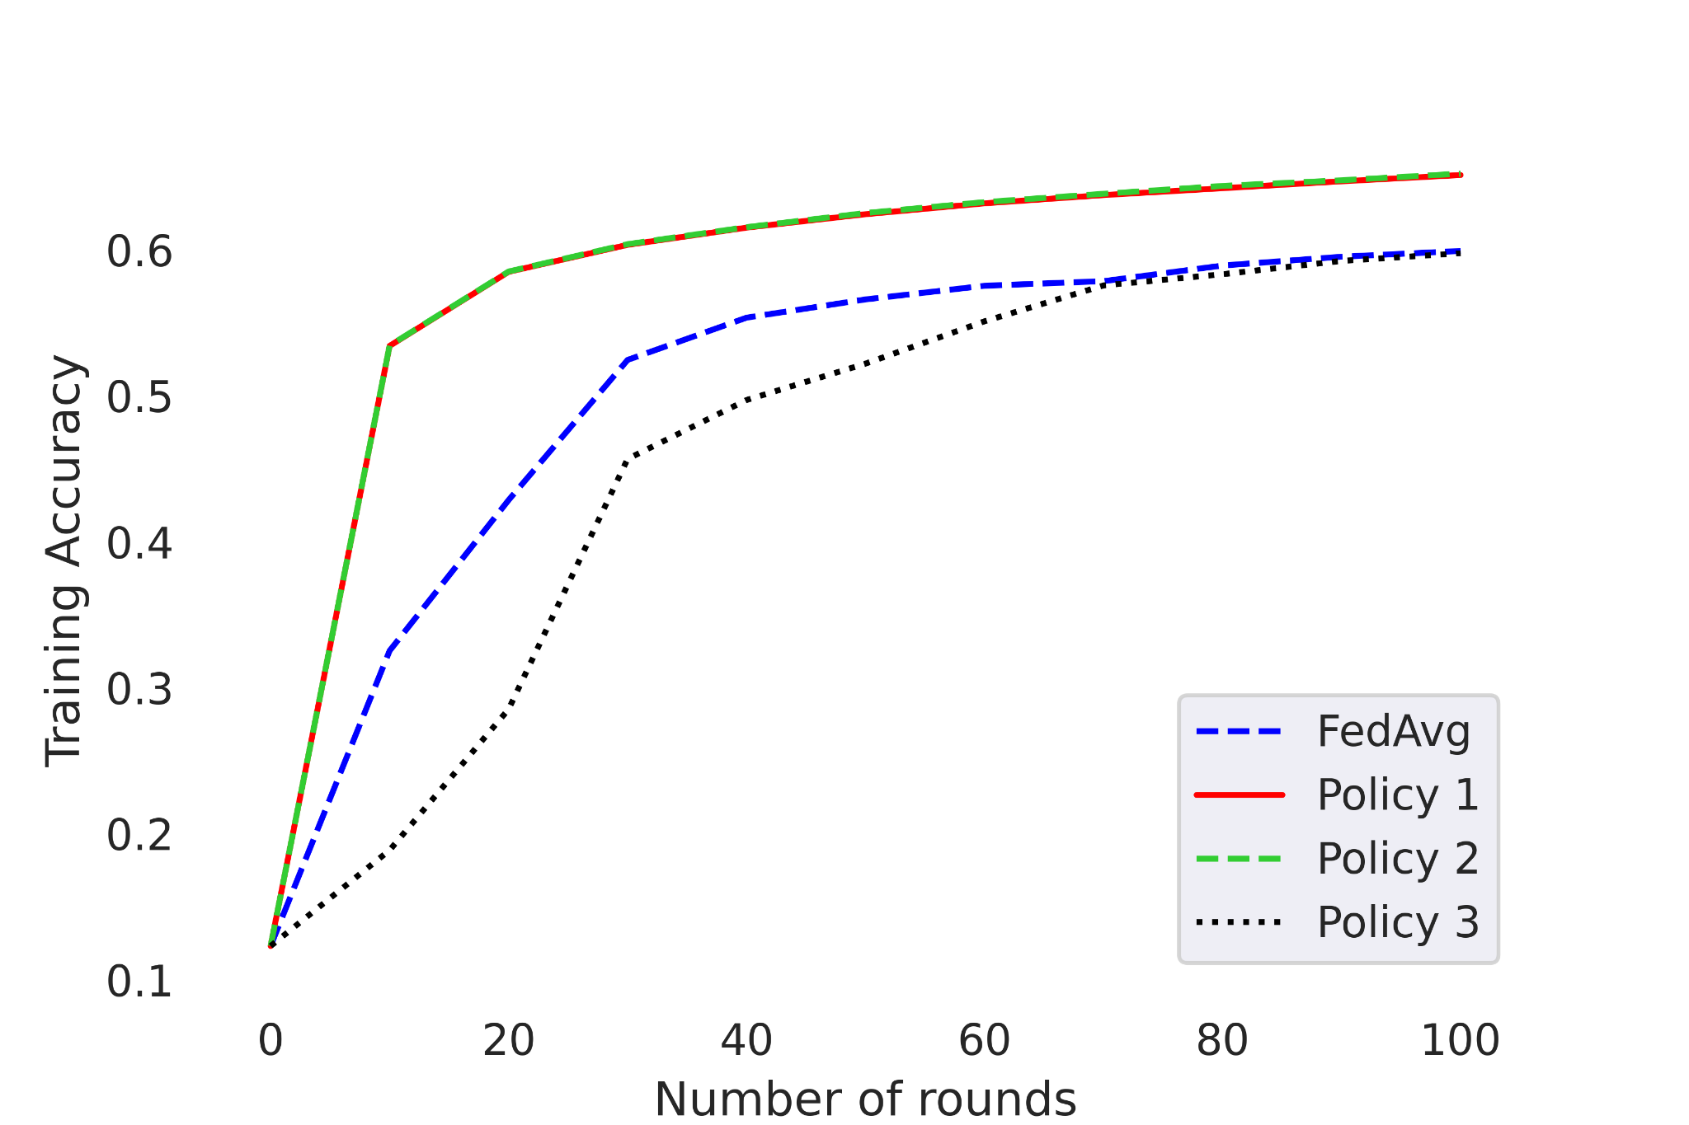
Training Accuracy

Slide 15
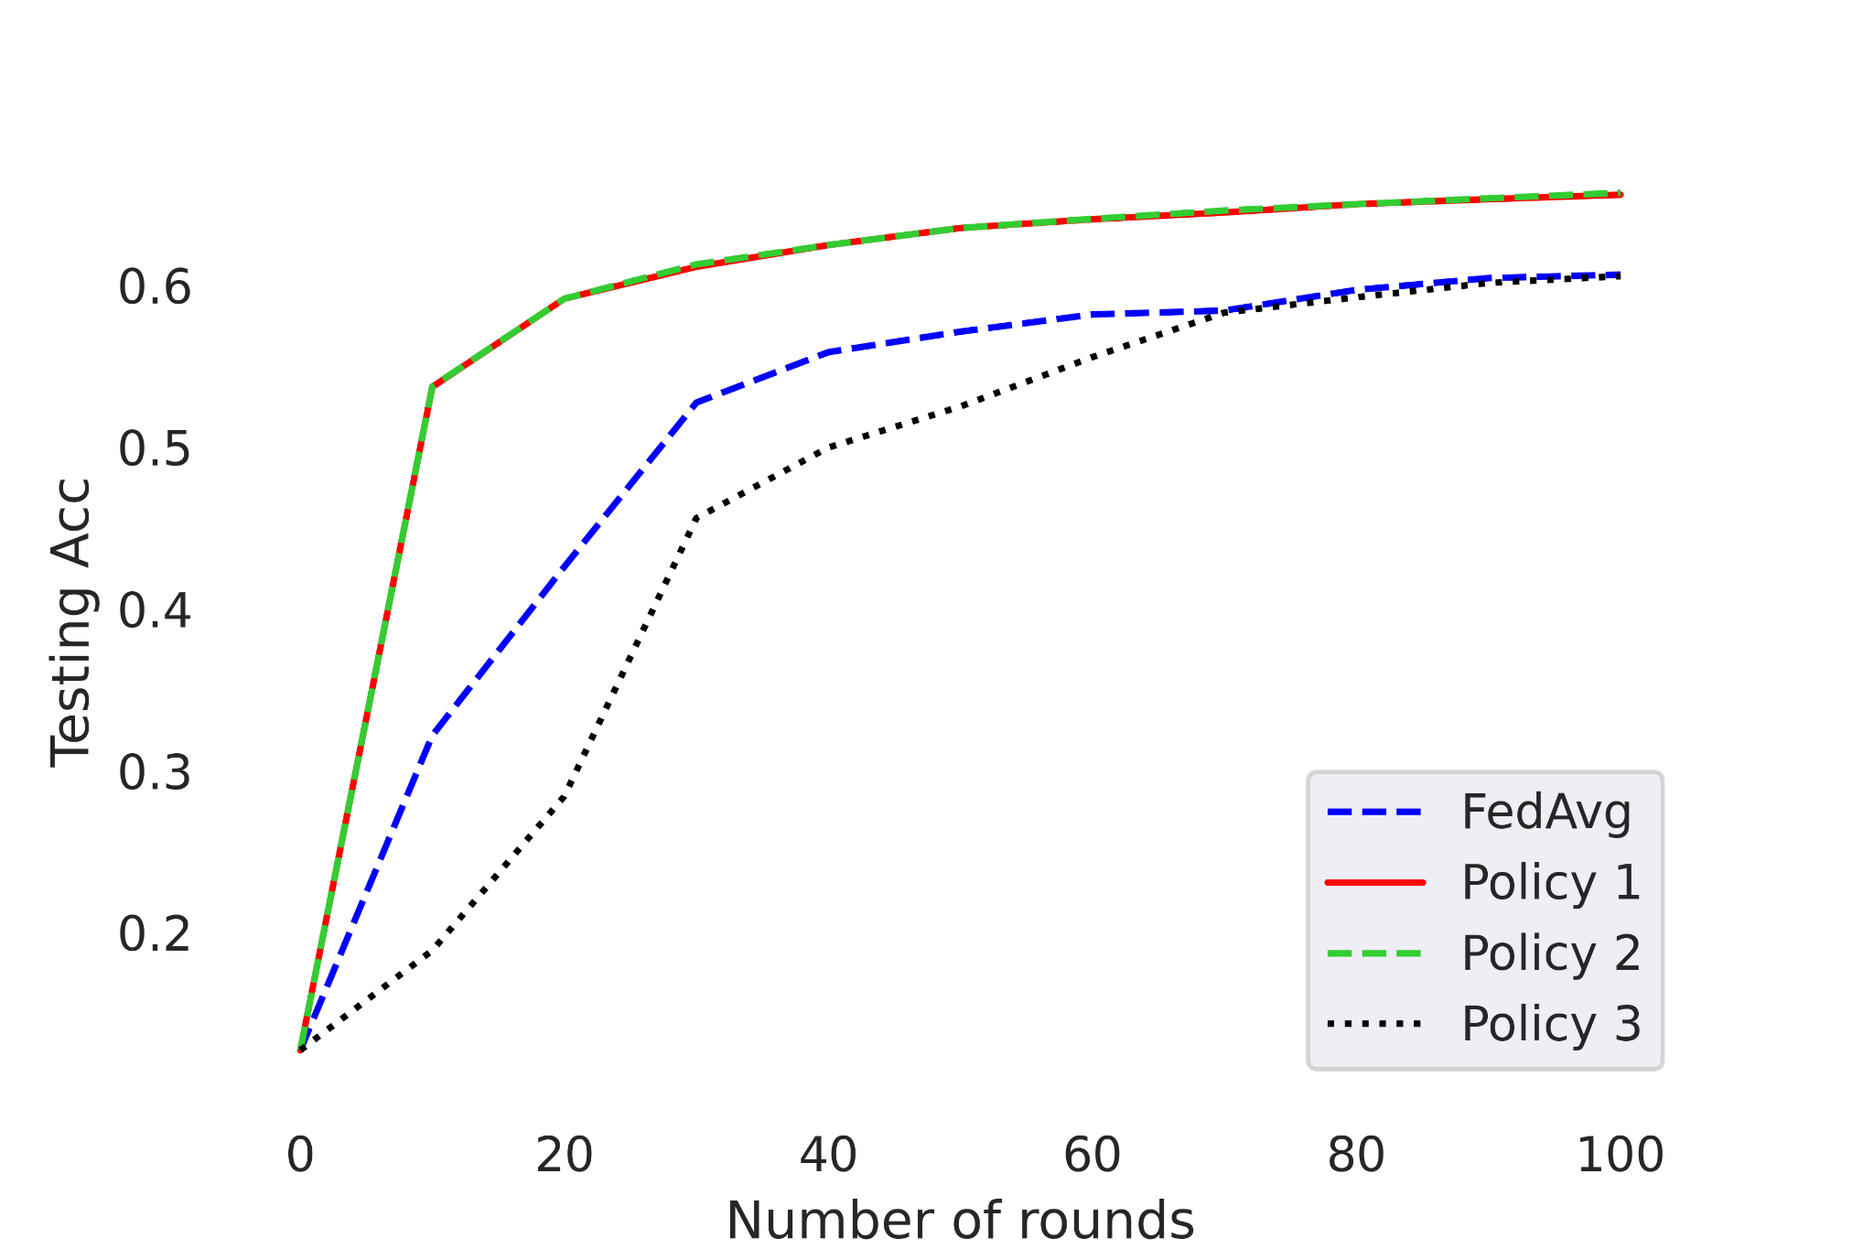
Testing Accuracy

Slide 16
We have compared different Federated Learning Client Selection Strategies.
Thanks!!

